Slide 1
Spatial in RavenDB 2.0
Simon Bartlett
simon@sibartlett.com
@sibartlett
github.com/sibartlett

Slide 2
Spatial in RavenDB 2.0
Spatial in RavenDB
Storing
Indexing
Querying
RavenBurgerCo (demo app)
Overview of how spatial indexes works

Slide 3
Examples of spatial data
“relating to, occupying, or having the character of space”
Business locations, buildings
Rivers, Forest boundaries
Weather and climate data
Satellite imagery
Medical imaging
Engineering/product designs

Slide 4
The value of Spatial Databases
There some queries that non-spatial databases can not answer…
List all the pharmacies within 15 kilometres of my house
List all gas stations along the route I plan to drive
List all the crash sites within the boundaries of a given airspace.

Slide 5
Spatial support in RavenDB 2.0
Geographic only (geodetic / spherical)
Support for indexing and querying:
Geometries specified in the Simple Features specification
Points, LineStrings (polylines), Polygons…
OGC and ISO standard (ISO 19125)
http://en.wikipedia.org/wiki/Simple_Features
Circles, and Rectangles / Envelopes

Slide 6
Simple Features
The geometries defined by the Special Feature Access standard are:
Points
LineStrings (polylines)
Polygons
Geometry collections
GeometryCollection
MultiPoint
MultiLineString
MultiPolygon

Slide 7
Well-known Text (WKT)
RavenDB supports indexing and querying shapes serialized as WKT
WKT is a text markup language for representing Simple Feature geometries
also defined in the Simple Feature Access specification
http://en.wikipedia.org/wiki/Well-known_text

Slide 8


WKT Examples (from Wikipedia)
POINT (30 10)
LINESTRING (30 10, 10 30, 40 40)

Slide 9


WKT Examples (from Wikipedia)
POLYGON ((30 10, 10 20, 20 40, 40 40, 30 10))
POLYGON ((35 10, 10 20, 15 40, 45 45, 35 10), (20 30, 35 35, 30 20, 20 30))

Slide 10
Custom syntax
Custom syntax for shapes not defined by the Simple Features standard:
Rectangle / Envelope
“{minX} {minY} {maxX} {maxY}”
Circle (radius is in kilometres)
“Circle({X} {Y} d={radius})”

Slide 11
RavenBurgerCo
Sample application
designed to demonstrate the spatial features in RavenDB
github.com/sibartlett/RavenBurgerCo
Clone, open in Visual Studio 2012, and hit F5!
This slide deck has been checked into this repository!

Slide 12
RavenBurgerCo – Restaurant Model
public class Restaurant
{
public string Name { get; set; }
public string Street { get; set; }
public string City { get; set; }
public string PostCode { get; set; }
public string Phone { get; set; }
public double Latitude { get; set; }
public double Longitude { get; set; }
public string DriveThruArea { get; set; }
public string DeliveryArea { get; set; }
}
{
"Name": "Raven Burger Co - Solihull",
"Street": "48 & 50/66 HIGH STREET",
"City": "SOLIHULL",
"PostCode": "B91 3TB",
"Phone": "0121 709 0708",
"Latitude": 52.41333,
"Longitude": -1.77879,
"DriveThruArea": "Circle(-1.77879 52.41333 d=5.0)",
"DeliveryArea": "POLYGON ((-1.77879 52.458263, -1.829679 52.395346, -1.727901 52.395346, -1.77879 52.458263))"
}

Slide 13
RavenBurgerCo - Index
We can index 2 doubles. No need t specify the field name!
Map = restaurants => from doc in restaurants
select new
{
_ = SpatialGenerate(doc.Latitude, doc.Longitude),
__ = SpatialGenerate("delivery", doc.DeliveryArea),
___ = SpatialGenerate("drivethru", doc.DriveThruArea)
};
The first argument is the field name, when indexing WKT.

Slide 14
RavenBurgerCo – Eat-in Example
The eat-in example allows the user to find restaurants within a 25 km radius of their location.
The index MUST be specified.
var restaurants = session.Query<Restaurant, RestaurantIndex>()
.Customize(x => x.WithinRadiusOf(25, latitude, longitude))
.ToList();
Kilometres

Slide 15
RavenBurgerCo – Mapping Example
The mapping example allows the user to pan and zoom a map, which displays restaurants.
Each time the map is zoomed or panned, we:
Get the new bounds of the map
Construct a rectangle string
Query the data store for restaurants within those bounds

Slide 16
RavenBurgerCo – Mapping Example
var rectangle = string.Format("{0} {1} {2} {3}", west, south, east, north);
var restaurants = session.Query<Restaurant, RestaurantIndex>()
.Customize(x => x.RelatesToShape(
Constants.DefaultSpatialFieldName,
rectangle,
SpatialRelation.Within
)
)
.ToList();
Constants.DefaultSpatialFieldName is the field name used
when the field was not WKT.

Slide 17
The technology behind RavenDB spatial
Lucene Spatial and spatial4j
Main contributor: David Smiley (github.com/dsmiley)
Lucene.NET Spatial and spatial4n
Ported from Java by: Itamar Syn-Hershko (github.com/synhershko)

Slide 18
How are geometries indexed?
Shapes are indexed using a grid index
There are two grid indexes:
Geohash tree
Quadtree
A worked example…

Slide 19
Geohash Index Example
For this example, we’ll use a Geohash index, with a level of 5.
The index looks like this:
Map = restaurants => from doc in restaurants
select new
{
_ = SpatialGenerate(
fieldname: “location”,
shapeWKT: doc.Point,
strategy: SpatialSearchStrategy.GeohashPrefixTree,
maxTreeLevel: 5
)
};

Slide 20
Geohash Index Example
We will index a point located at: 42.34493, -71.093232
Fenway Victory Gardens, Boston, Massachusetts, U.S.A

Slide 21
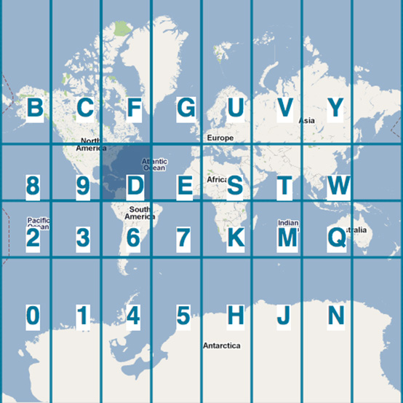
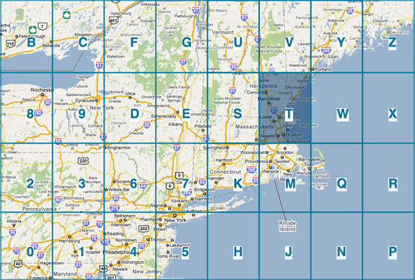
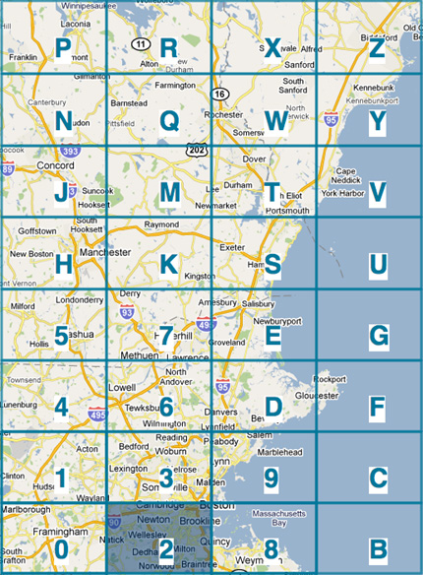
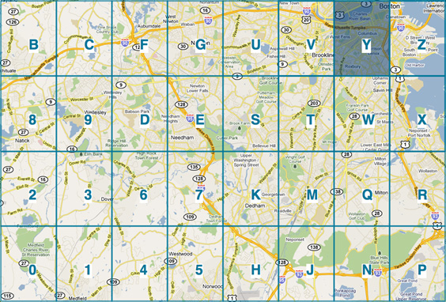
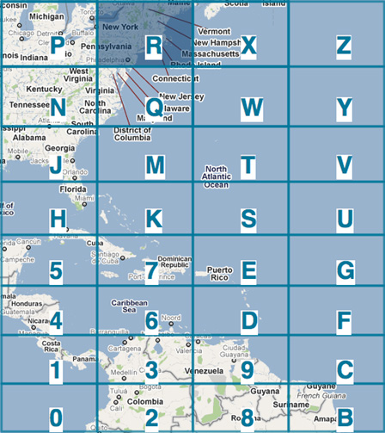
Geohash: Level 2
Geohash: Level 1
Geohash: Level 3
Geohash: Level 5
Geohash: Level 4
The previous grid cell is then divided into 32 rectangles
Fenway Victory Gardens is located in cell R
Geohash at level 2 is: DR
The surface of the Earth is projected on to a rectangle
Then divided into 32 rectangles
Fenway Victory Gardens is located in cell D
Geohash at level 1 is: D
The previous grid cell is then divided into 32 rectangles
Fenway Victory Gardens is located in cell U
Geohash at level 3 is: DRU
The previous grid cell is then divided into 32 rectangles
Fenway Victory Gardens is located in cell Y
Geohash at level 5 is: DRU2Y
The previous grid cell is then divided into 32 rectangles
Fenway Victory Gardens is located in cell 2
Geohash at level 4 is: DRU2

Slide 22
Geohash: DRU2Y
We configured the index to go to a depth of 5 levels
The more levels used, the more precise the index
Each Geohash would cover less area

Slide 23
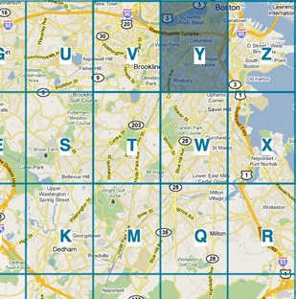
Example query
We want all documents within a given radius of a specific location
Use a circle as our search criteria
The circle intersects with grid cells:
DRU2K
DRU2M
DRU2Q
DRU2R
DRU2S
DRU2T
DRU2U
DRU2V
DRU2W
DRU2X
DRU2Y
DRU2Z

Slide 24
Searching the index
Query
Index
DRU2K
DRU2M
DRU2Q
DRU2R
DRU2S
DRU2T
DRU2U
DRU2V
DRU2W
DRU2X
DRU2Y
DRU2Z
…
HE5KV
DRU2Q
3GP08
DR3HN
Z01K3
DRU2Y
K4YD2
TJ201
10DF3
DR302
…
The circle’s Geohashes become our query criteria
We search the index for any Geohashes that match those in our criteria

Slide 25
For more on Geohash indexing…
Geohash: http://en.wikipedia.org/wiki/Geohash
Presentations by David Smiley
Geospatial Search Using Geohash Prefixes: http://bit.ly/YGE7S2
Lucene 4 Spatial: http://slidesha.re/XOeu2p

Slide 26
Thank you
Simon Bartlett
simon@sibartlett.com
@sibartlett
github.com/sibartlett

